Slide 1
Shell Bootcamp 2024 3 Reflections for Week 2
Paryushi Jain
Date :6th September 2024

Slide 2

My learnings from this week!

Slide 3
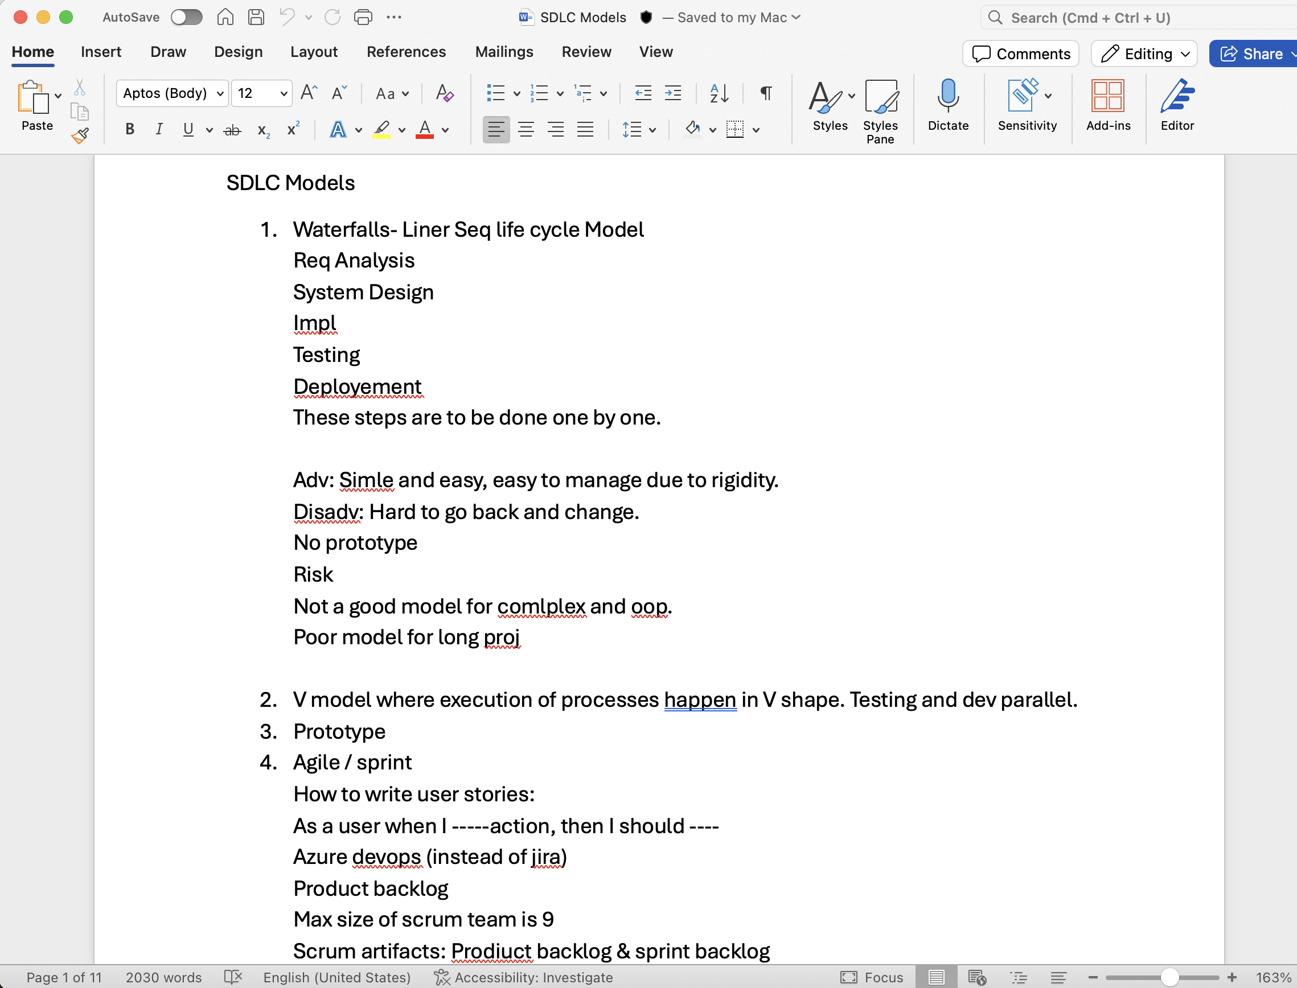
Learning 1 | My takeaways
Agile methodology and SDLC
Key Learning: Agile and the Software Development Life Cycle (SDLC) are methodologies that help streamline project management and software development. Agile focuses on iterative development, where requirements and solutions evolve through collaboration between self-organizing cross-functional teams. SDLC, on the other hand, is a process used to design, develop, and test high-quality software.
Key Takeaway:
Agile: Emphasizes flexibility, customer satisfaction, and rapid delivery of functional software. It allows for continuous improvement and adaptation to changing requirements.
SDLC: Provides a structured approach to software development, ensuring that all necessary steps are followed to deliver a high-quality product. It includes phases like planning, analysis, design, implementation, testing, deployment, and maintenance.
In the energy sector, Agile and SDLC can be implemented to enhance project management and software development processes.

Slide 4
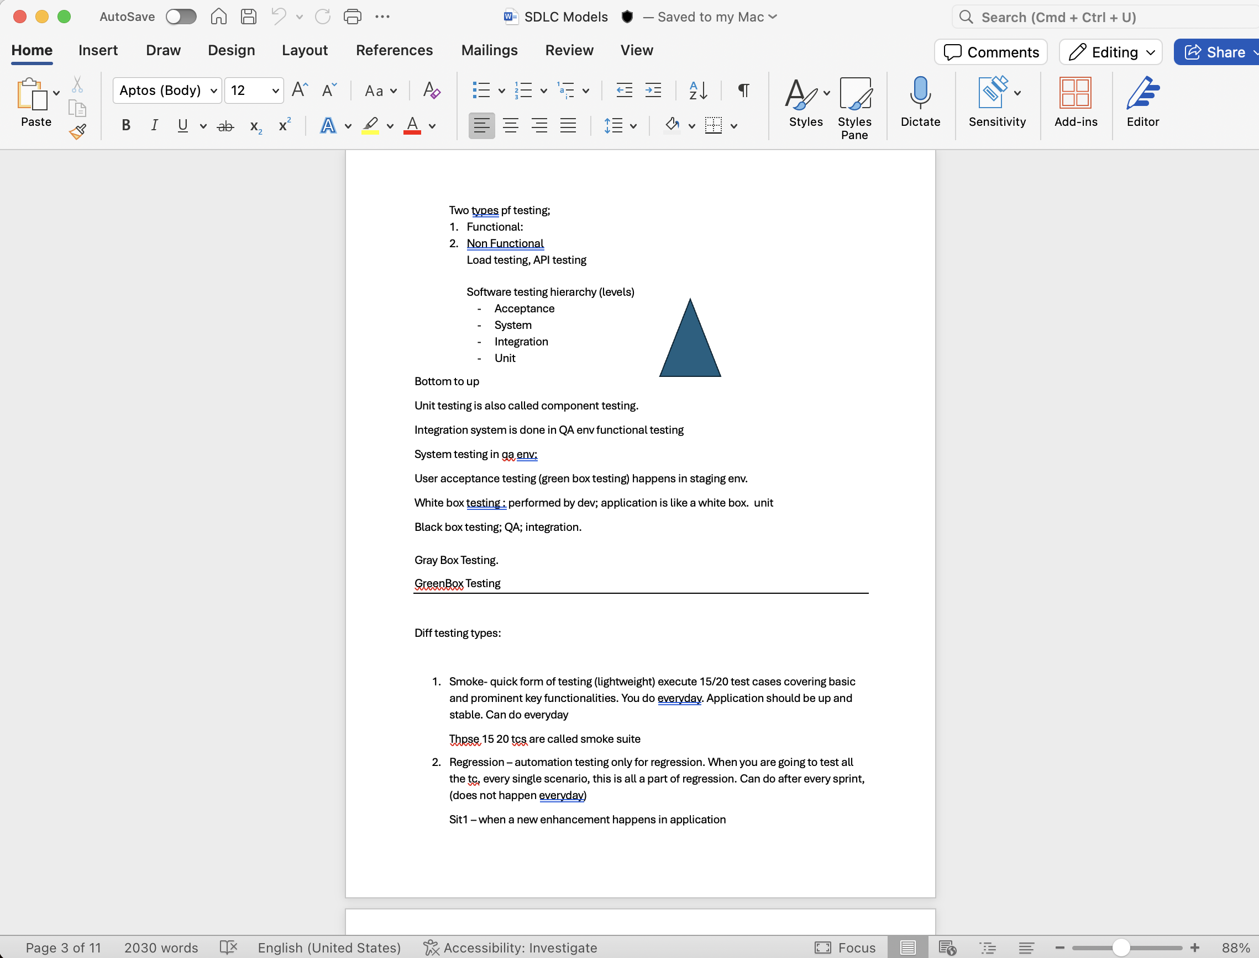
Learning 2 | My takeaways
Software Testing
Key Learning: Testing and the Software Testing Life Cycle (STLC) are crucial for ensuring that software meets specified requirements and functions correctly. STLC involves various stages such as requirement analysis, planning, test case development, environment setup, test execution, and test cycle closure. Each phase is designed to identify and fix defects early, ensuring high-quality software delivery.
Key Takeaway: STLC provides a structured framework for testing, ensuring thorough coverage and early detection of defects. Effective testing improves the reliability and performance of software, leading to higher customer satisfaction and reduced maintenance costs.
In the energy sector, STLC can be implemented to ensure the reliability and efficiency of energy management systems, smart grid technologies, and other software used in energy production and distribution. By following STLC, energy companies can develop robust systems that meet regulatory standards and optimize energy usage.

Slide 5
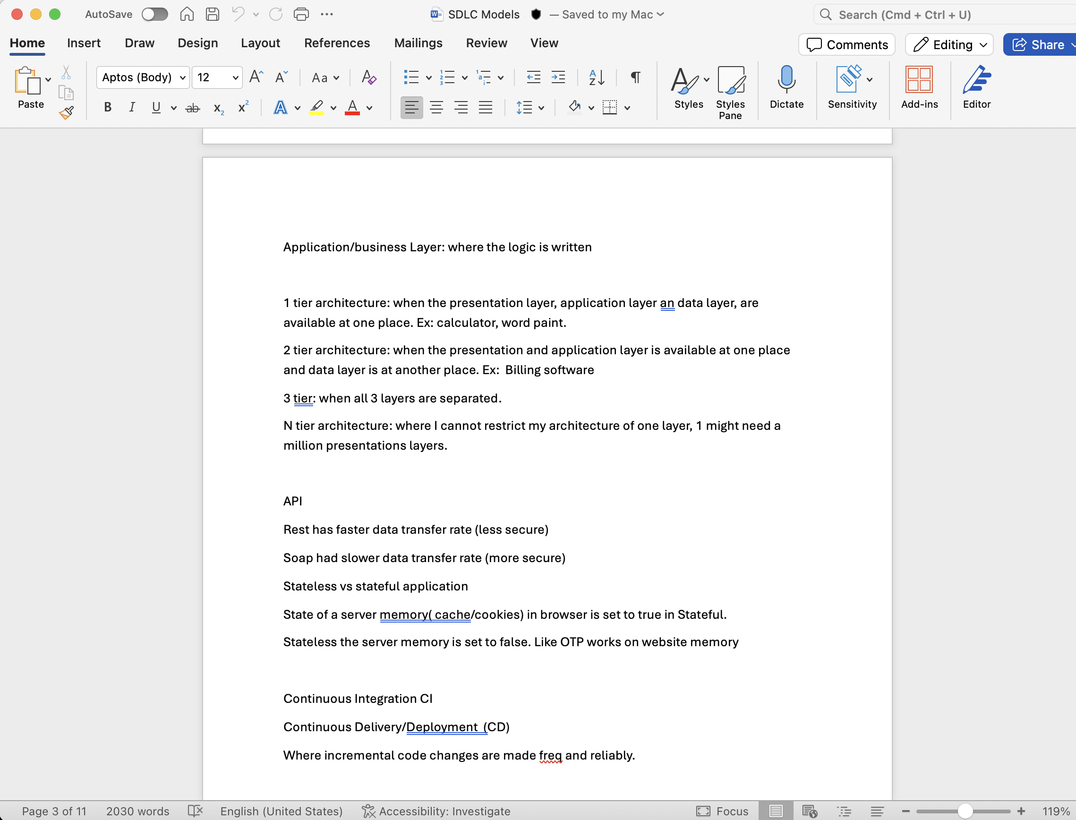
Learning 3 | My takeaways
CI/CD
Key learning: Continuous Integration (CI) and Continuous Deployment (CD) are practices designed to improve code quality and expedite the release process. CI involves regularly merging code changes into a central repository, followed by automated builds and tests. CD automates the delivery of applications to selected infrastructure environments.
Key takeaway: The main advantage of CI/CD is that it allows for rapid iteration, immediate feedback on errors, and quick delivery of new features and fixes to users without disrupting service. This leads to more reliable and efficient software development.
In the energy sector, CI/CD can be implemented to manage and update systems that control energy production, distribution, and consumption efficiently. For example, smart grid technology could benefit from continuous updates that improve performance or security without interrupting service.

Slide 6

Relevance of learnings for my organization

Slide 7

Learning 1 | Relevance for Shell
Shell implements Agile methodologies through its “Edge” approach, which combines Agile principles with Scrum and DevOps practices. This allows for continuous delivery and iterative development, enabling Shell to adapt quickly to changes and deliver projects efficiently. Additionally, Shell uses the SDLC framework to develop robust energy management systems and predictive maintenance software, ensuring thorough planning, design, testing, and maintenance.
By integrating Agile and SDLC, Shell gains increased flexibility and adaptability, allowing it to respond swiftly to market changes and technological advancements. This approach enhances collaboration and communication among teams, leading to higher quality products and reduced time to market. Overall, these methodologies improve Shell’s efficiency, resulting in cost savings and better resource management.

Slide 8
Learning 2 | Relevance for Shell
Shell uses Agile and SDLC methodologies to develop energy management systems and predictive maintenance software, ensuring thorough planning, iterative development, and continuous delivery.
These methodologies enhance flexibility, improve collaboration, and ensure high-quality software delivery, leading to increased efficiency, reduced downtime, and better resource management.

Slide 9
Learning 3 | Relevance for Shell
Shell uses CI/CD pipelines to automate the integration and deployment of software updates, ensuring continuous delivery and rapid iteration for their energy management and smart grid systems.
CI/CD enhances Shell’s software reliability, reduces deployment time, and allows for quick adaptation to technological advancements, ultimately improving operational efficiency and customer satisfaction.

Slide 10

Challenges in implementing learning

Slide 11
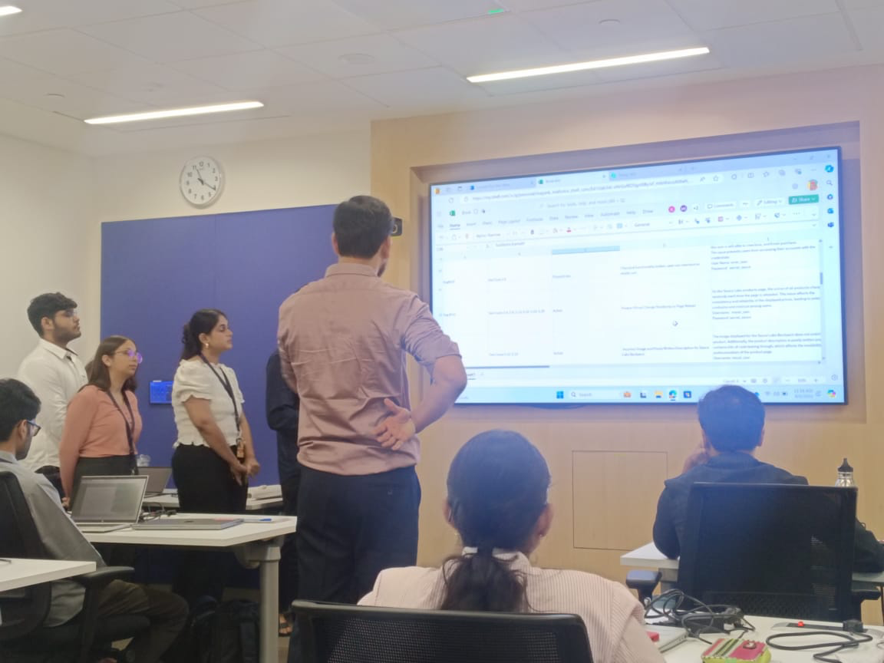
Challenge faced while implementing Learning 1
Implementing Agile and SDLC methodologies can present several challenges. One common challenge is resistance to change, especially if you or your team are accustomed to traditional workflows. This resistance can slow down the adoption process and create friction within the team.
To overcome the challenge, I created user stories on azure Devops.
https://github.com/ParyushiJain/JourneyPPT/blob/main/TestCase.docx

Slide 12
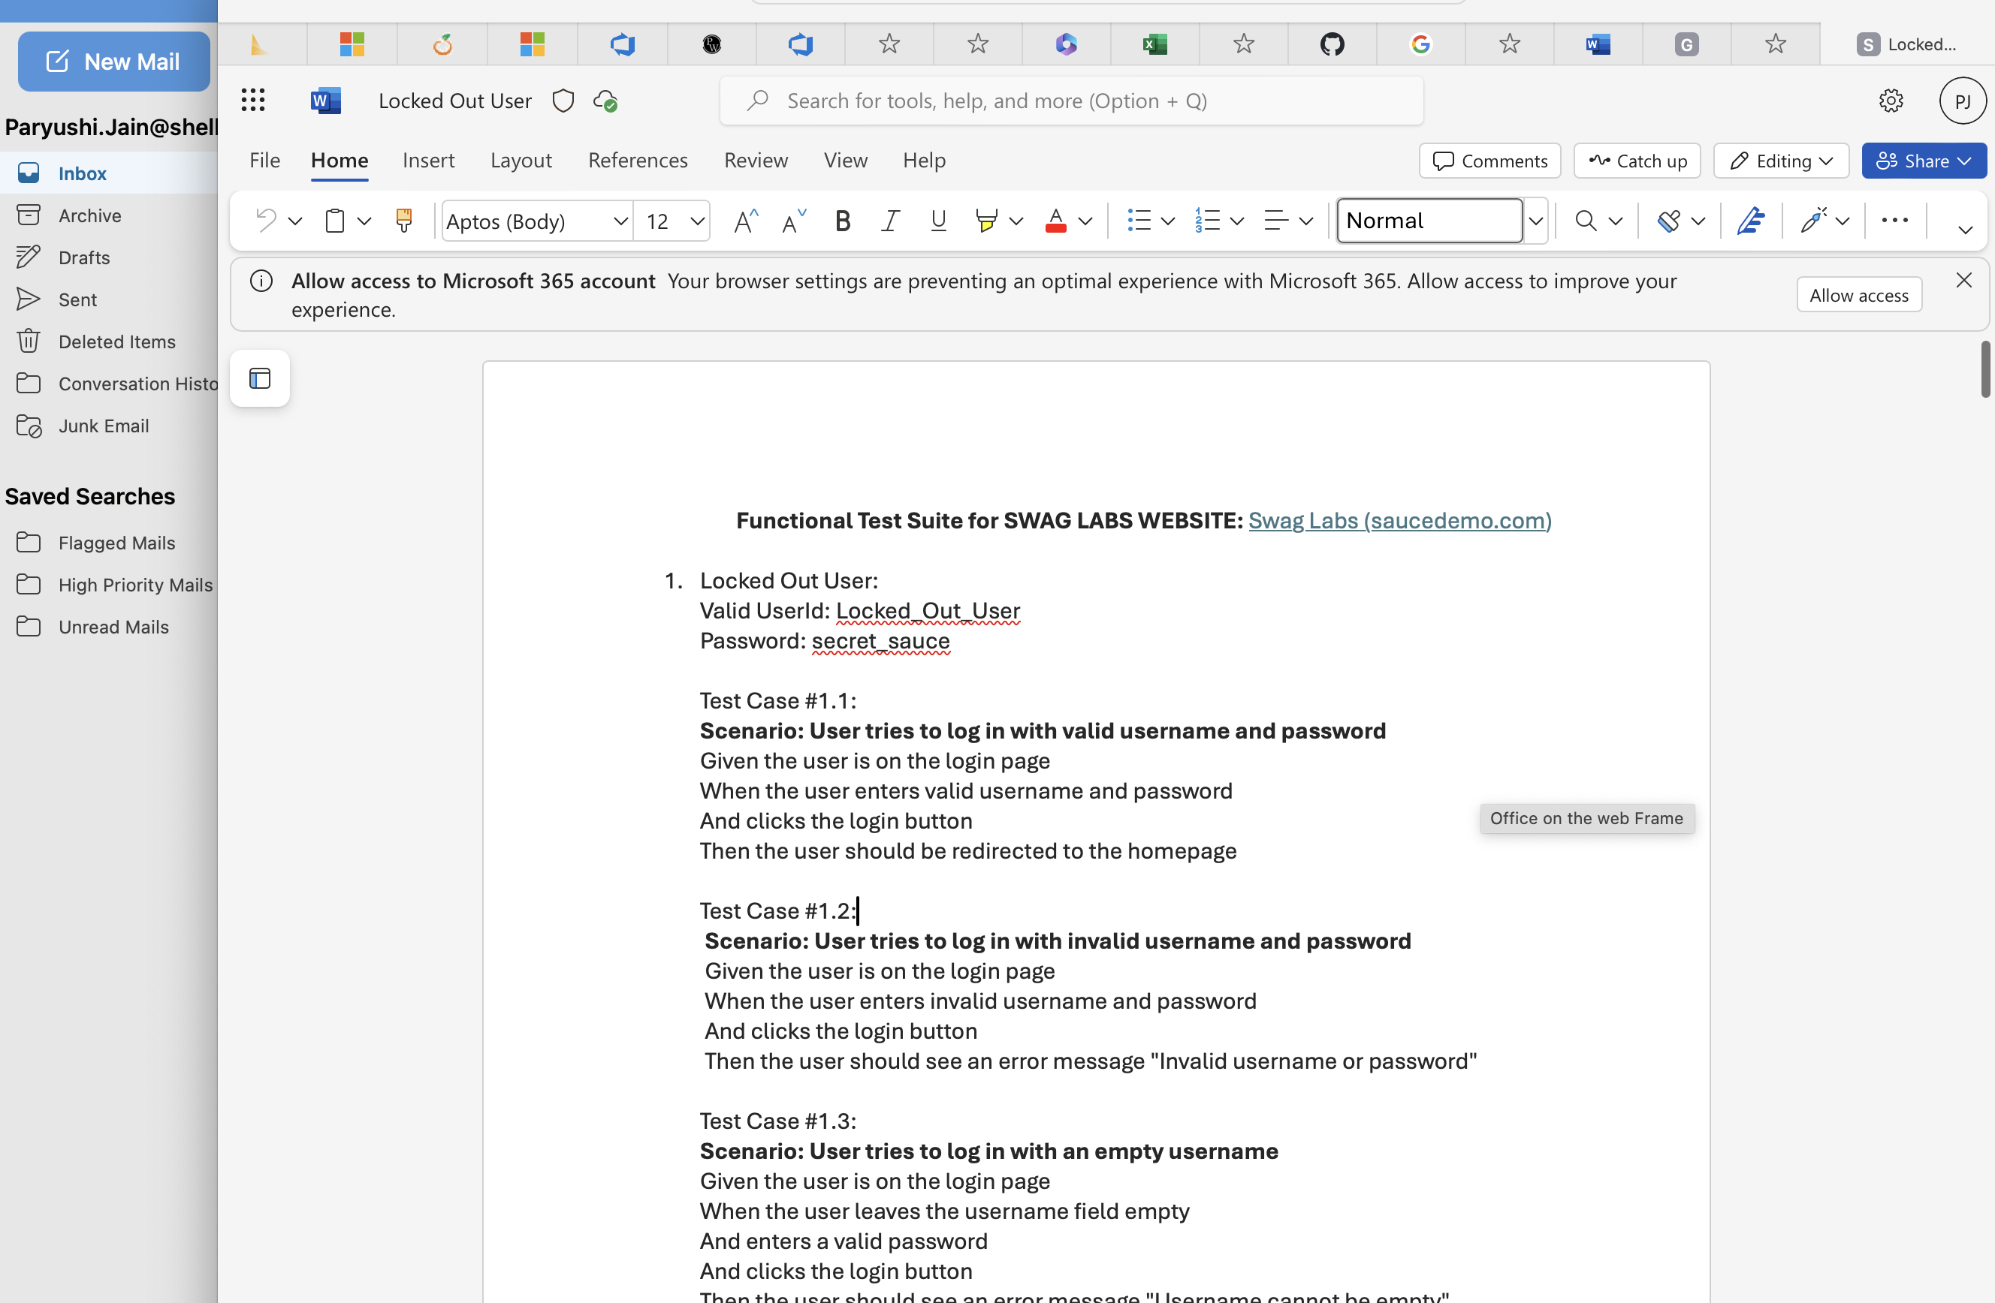
Challenge faced while implementing Learning 2
Learning about testing and STLC can be challenging due to the rapidly changing technologies and complex technical requirements specific to energy systems. Additionally, understanding and applying the various phases of STLC requires a significant amount of time and effort.
I overcame it by writing test cases
https://github.com/ParyushiJain/JourneyPPT/blob/main/TestCase.docx

Slide 13
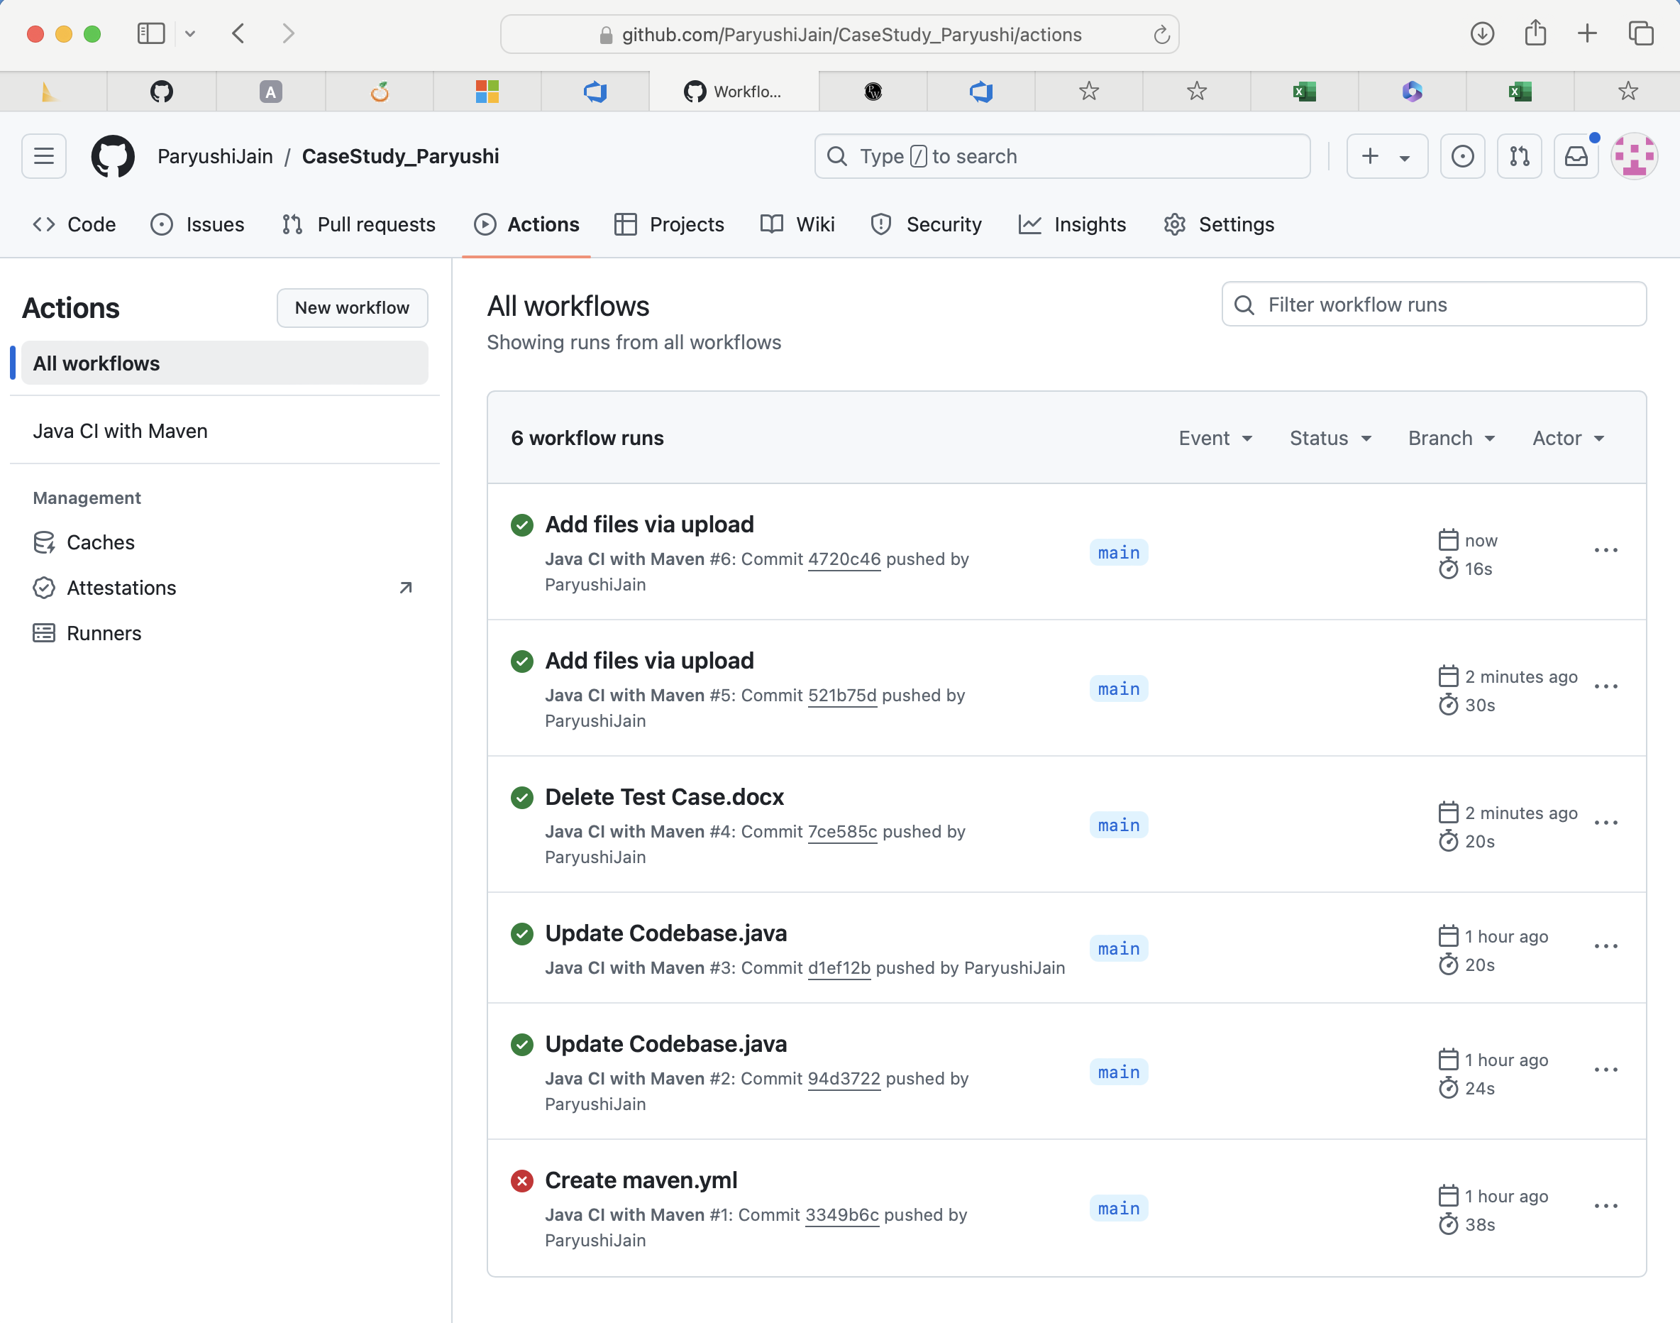
Challenge faced while implementing Learning 3
Learning CI/CD can be challenging due to the complexity of automation tools, integrating various parts of the software delivery pipeline seamlessly, ensuring high-quality test coverage for all new code commits, and maintaining a stable deployment environment amidst frequent changes.
I overcame this by implanting Github Actions Automation
https://github.com/ParyushiJain/CaseStudy_Paryushi

Slide 14

Action Plan

Slide 15
My Action Plan for this Week
Actions
Timeline
Status
Implement iterative development cycles, conduct regular sprint planning and review meetings, perform requirement analysis, develop test cases, set up testing environments, execute tests, and automate integration and deployment processes. Ensure continuous feedback integration and adaptation to changes.
Ongoing and continuous, with specific project phases aligned to software development cycles. Iterative cycles (e.g., 2-week sprints) and continuous integration and deployment activities are integrated into daily development tasks.
Active. I am continuously learning delivering, testing, and deploying updates, ensuring high-quality software delivery and rapid adaptation to changes.

Slide 16

Learning is also Fun!

Slide 17
Learning is also Fun!
Case Study:
We have completed a case study covering user stories, testing, bug reports and CI/CD using GitHub Actions.
The case study was challenging and fun, experiencing how the SDLC works.
[Add a graphic or a picture of how you/your team enjoyed the new learning]

Slide 18

Summary
Implementing Agile, STLC, and CI/CD methodologies collectively enhances project management and software development processes. Actions include iterative development cycles, regular sprint planning, requirement analysis, test case development, environment setup, test execution, and automated integration and deployment.
These methodologies improve flexibility, collaboration, efficiency, and overall software quality, benefiting organizations like Shell in the energy sector.

Slide 19
Thank You

